Slide 1
Excel Capstone:-2
A.Sai Akhilesh

Slide 2


TOPIC (IPL DATASET VISUALISATION)

Slide 3
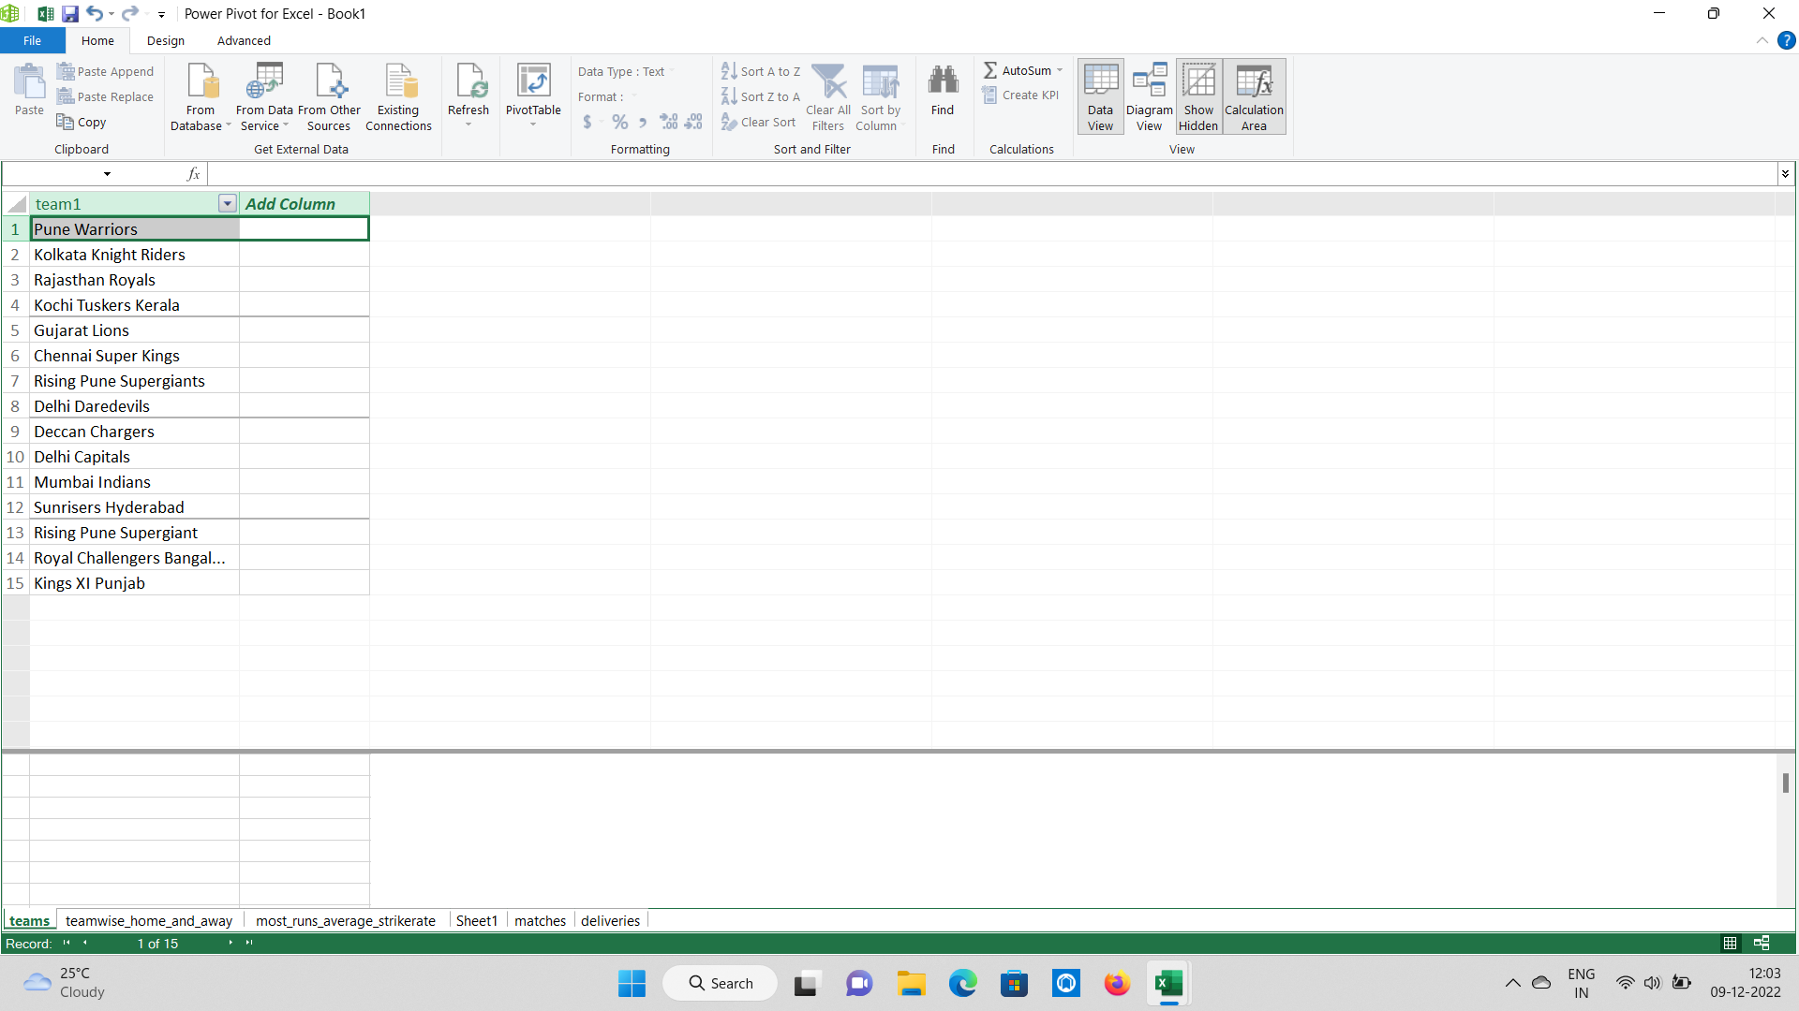
1. Import all the data using power Pivot?
Check the extension of the file which you want to import.
Go to Power pivot click on manage then select the “from other sources” in the ribbons.
Select the file type>select the file.
Import the data in Power Pivot in Excel.

Slide 4
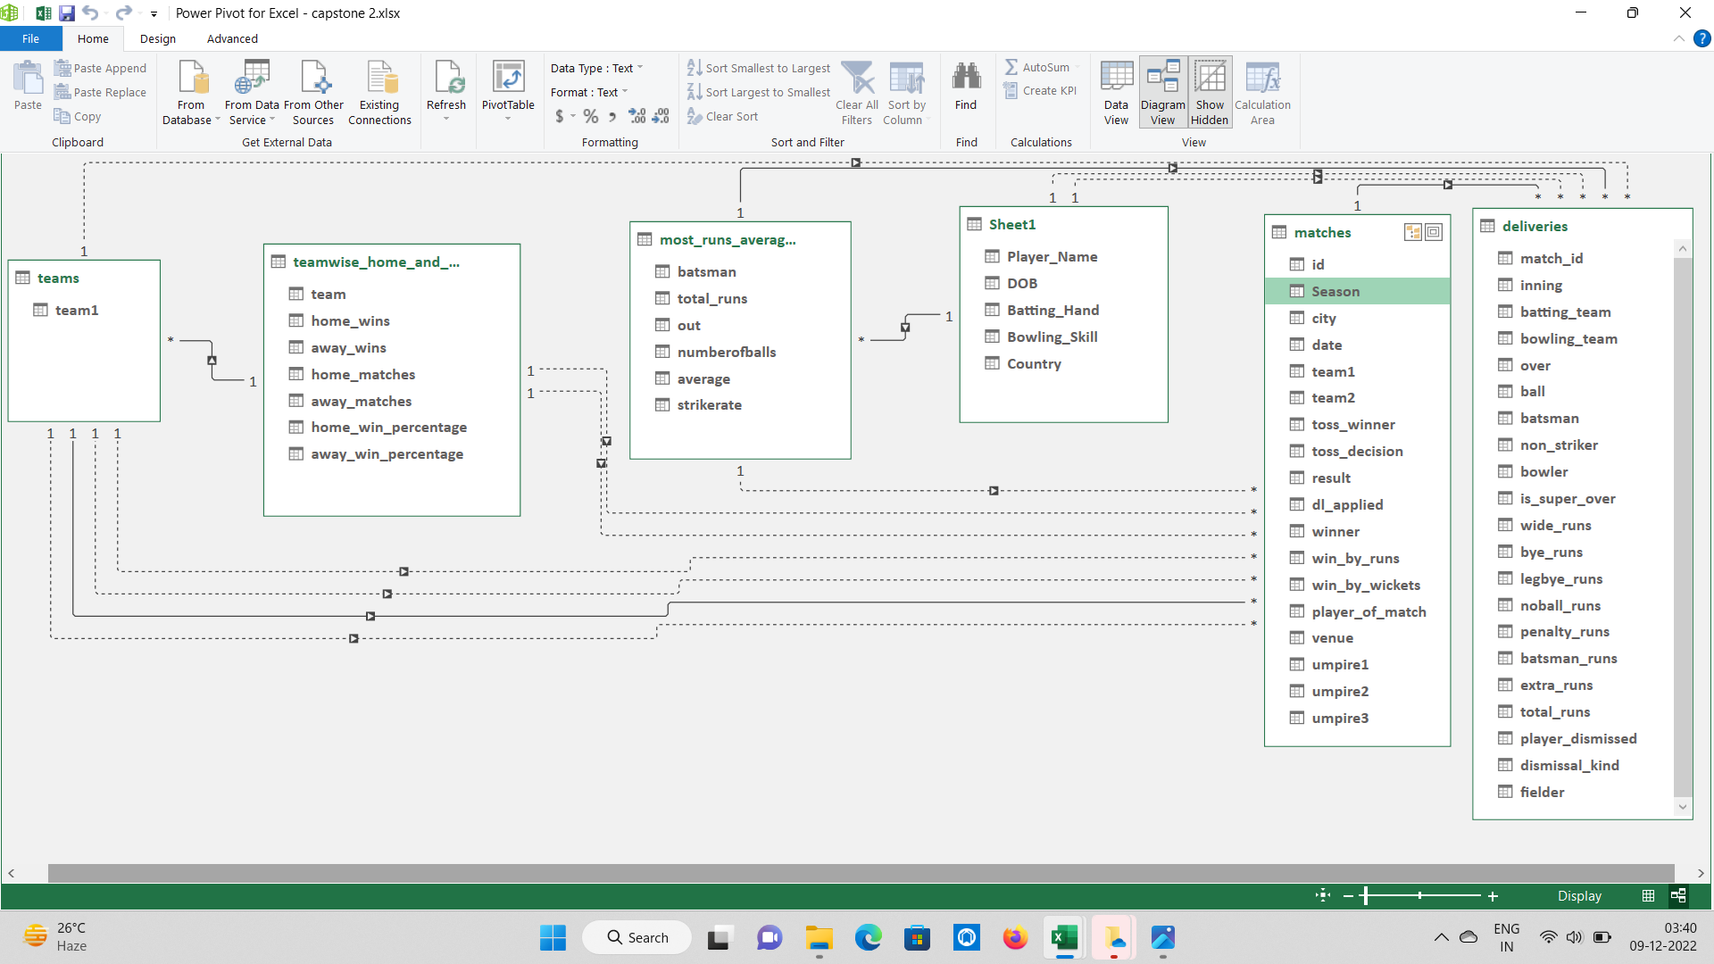
2. Create all the possible relationships between the tables?
After import the data in power pivot we make relationships between tables click on home select diagram view we have 6 tables create the relationship between them .I create 14 relationships between the tables .In relationship between the tables form a lines ,the dark line indicates the relationship is in “active” there are 5 active relationships and doted lines indicates the relationship is in “inactive” there are 9 inactive relationships. With the help of the active relationships we can connect the tables and create pivot tables and make the solutions more easy.

Slide 5
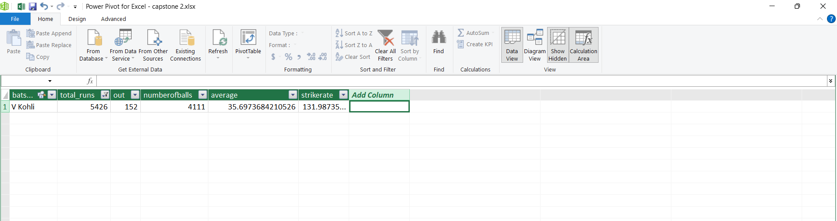
3. Which player scored more runs in the IPL and their average?
First select the sheet of most_runs_average_strikerate from the given data and apply the filters to the total runs then we get the player and their average.
V Kohli scored more runs in the IPL and their average is 35.6973

Slide 6
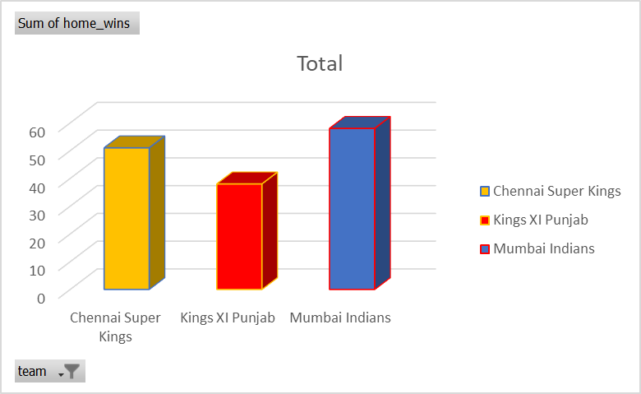
4. Name 3 teams who won more matches in their home ground and visualization?
Create a pivot table from the power pivot . Arrange the teams in rows and sum of home towns
in values and apply filter values to top 3 then we get the top 3 teams won in home grounds .
Chennai Super Kings , Kings XI Punjab , Mumbai Indians are the top 3 teams won more matches
in their home ground.
Row Labels | Sum of home_wins
Chennai Super Kings | 51
Kings XI Punjab | 38
Mumbai Indians | 58
Grand Total | 147

Slide 7
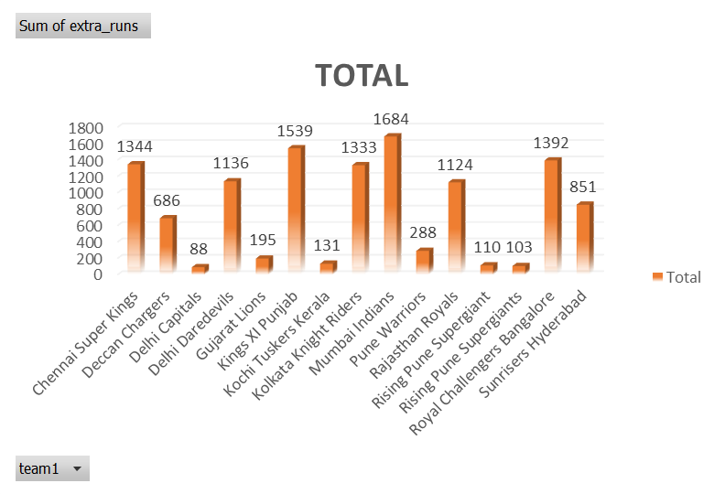
5. Teams and how many extra runs they conceded?
Create a pivot table from the power pivot . Arrange the teams in rows and select the column of extra runs arrange into values of pivot table then we get the extra runs conceded by the teams and also we can represent that extra runs in charts also.
Row Labels | Sum of extra_runs
Chennai Super Kings | 1344
Deccan Chargers | 686
Delhi Capitals | 88
Delhi Daredevils | 1136
Gujarat Lions | 195
Kings XI Punjab | 1539
Kochi Tuskers Kerala | 131
Kolkata Knight Riders | 1333
Mumbai Indians | 1684
Pune Warriors | 288
Rajasthan Royals | 1124
Rising Pune Supergiant | 110
Rising Pune Supergiants | 103
Royal Challengers Bangalore | 1392
Sunrisers Hyderabad | 851
Grand Total | 12004

Slide 8
6. How many Total superover matches are played(replace 0 with non- superover matches and 1 with superover matches)?
Create a pivot table from power pivot . Select the season column and arrange it into rows and arrange superover Column into values then we get the total superovers. Which the value is 0 that is non-superover
and remaining values are superover. I use “IF” formula
for the over column in that column the value of 0 gives non-superover and for values gives the superover.
Total 81 superover matches are played.
Row Labels | Sum of is_super_over | Over
IPL-2008 | 0 | non-superover
IPL-2009 | 11 | superover
IPL-2010 | 9 | superover
IPL-2011 | 0 | non-superover
IPL-2012 | 0 | non-superover
IPL-2013 | 25 | superover
IPL-2014 | 12 | superover
IPL-2015 | 11 | superover
IPL-2016 | 0 | non-superover
IPL-2017 | 13 | superover
IPL-2018 | 0 | non-superover
IPL-2019 | 0 | non-superover
Grand Total | 81

Slide 9
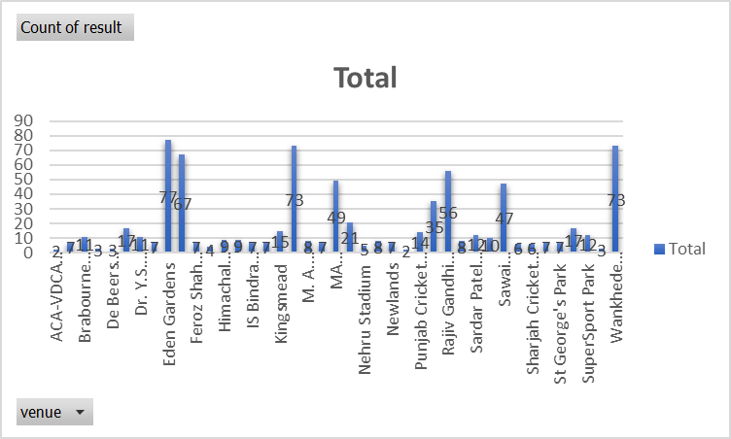
7. Which stadium records highest wins and visualization of the data?
Create a pivot table from power pivot. Select the venue column and arrange it into rows,select the result column and arrange it into values. Apply the condition formatting for the result then we get the stadium with highest wins.
Eden Gardens has the highest records in wins when compared to the all stadiums we can identify the stadium when we see the above chart.

Slide 10
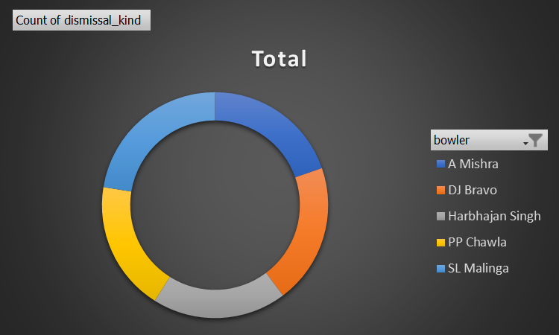
8. Top 5 wicket takers and the visualization(Doughnut chat)?
Create a pivot table from power pivot.Select the bowlers column and arrange it into rows and select the dismissal kind column arrange it into values.Dismissal means batters innings is brought to an end by the opposing team that is nothing but wicket taking.
A Mishra,DJ Bravo,Harbhajan Singh,PP Chawla,SL Malinga are the 5 wicket takers .
Row Labels | Count of dismissal _ kind
A Mishra | 165
DJ Bravo | 168
Harbhajan Singh | 161
PP Chawla | 156
SL Malinga | 188
Grand Total | 838

Slide 11
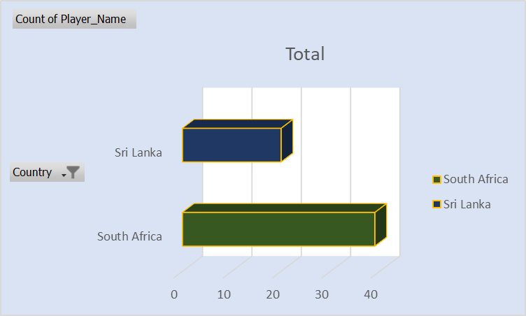
9. How many players from Sri Lanka and south Africa represent using bar graphs?
Create a pivot table from power pivot. Select the country column and arrange it into rows
and select the players names column arrange it into values apply filter to the countries select the countries asked in the question then we get the count of the players in south Africa and Sri Lanka.
Row Labels | Count of Player _ Name
South Africa | 39
Sri Lanka | 20
Grand Total | 59
South Africa contains 39 players.
Sri Lanka contains 20 players.

Slide 12

T
a
k
y
u
h
n
o

